Slide 1

Cloud storage: gcs vs aws vs azure

Slide 2

AGENDA
Overview of cloud storage in modern distributed systems
Importance of cloud providers: Google Cloud Storage (GCS), Amazon Web Services (AWS), and Microsoft Azure
Key focus: Features, use cases, and comparisons

Slide 3

A Comprehensive Overview of Cloud Storage Services in Distributed Systems

Slide 4

What is cloud storage?
Cloud storage enables users to store, access, and manage data remotely
Provides scalability, reliability, and security
Used in enterprises, startups, and personal applications

Slide 5
Overview of AWS S3
Full Name: Amazon Simple Storage Service (S3)
Key Features: Object storage, high durability (99.999999999%), lifecycle policies, security via IAM
Use Cases: Hosting websites, backup & disaster recovery, data lakes
Pricing Model: Pay-per-use with different storage classes (Standard, Glacier, etc.)

Slide 6
Overview of Google Cloud Storage (GCS)
Full Name: Google Cloud Storage
Key Features: Global edge caching, automatic redundancy, fine-grained access control
Use Cases: Big data processing, media storage, AI/ML datasets
Pricing Model: Pay-as-you-go with storage classes (Standard, Nearline, Coldline, Archive)

Slide 7
Overview of Microsoft Azure Blob Storage
Full Name: Azure Blob Storage
Key Features: Hierarchical namespaces, hybrid cloud integration, enterprise-grade security
Use Cases: Enterprise applications, hybrid cloud, analytics workloads
Pricing Model: Tiers (Hot, Cool, Archive) based on access frequency

Slide 8
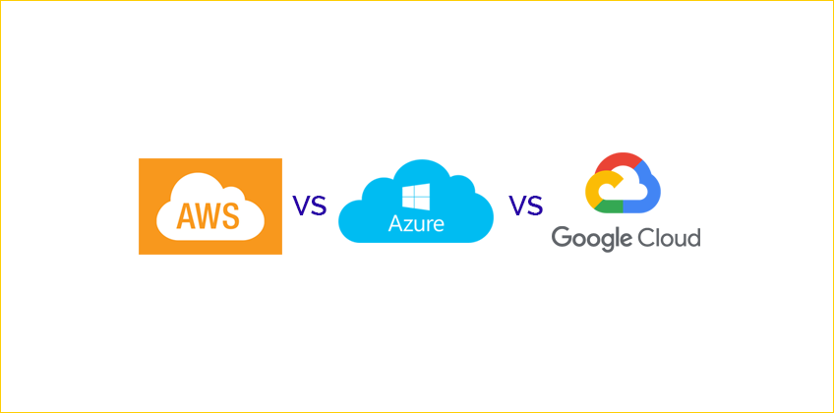
_

Slide 9
Performance comparison
AWS S3: Optimized for high availability and low latency
GCS: Superior for analytics and AI workloads
Azure Blob: Best suited for hybrid and enterprise solutions

Slide 10
Major Comparisons Between AWS, GCS, and Azure
Feature | AWS | GCS | Azure
Best For | Large-scale enterprises | AI/ML, Big Data | Hybrid cloud, Enterprises
Object Storage | Amazon S3 | Google Cloud Storage | Azure Blob Storage
Block Storage | Amazon EBS | Persistent Disks | Azure Disks
Cold Storage | Amazon Glacier | Archive Storage | Azure Cool/Archive Tier
AI/ML Integration | AWS SageMaker | TensorFlow, BigQuery | Azure AI

Slide 11

Security and compliance
AWS: IAM roles, encryption, compliance with major standards
GCS: Fine-grained access controls, global security standards
Azure: Integrated security tools, compliance with enterprise regulations

Slide 12
Scalability and availability
AWS S3: Multi-region replication, 11 9’s durability
GCS: Strong consistency, automatic redundancy
Azure: Multi-tiered storage with geo-redundancy

Slide 13
Pricing and cost efficiency
AWS: Flexible, but long-term storage can be costly
GCS: Competitive pricing, cost-effective for data analytics
Azure: Cost-efficient for enterprise and hybrid cloud users

Slide 14

Real-World Use Cases
AWS: Netflix for video streaming, Airbnb for hosting images
GCS: Google Photos, AI/ML workloads
Azure: Microsoft 365 data storage, hybrid cloud for enterprises

Slide 15
conclusion
Choose AWS S3 for general-purpose storage with high availability
Choose GCS for AI, analytics, and high-performance data processing
Choose Azure Blob for hybrid cloud and enterprise integration
Cloud storage choice depends on use case, budget, and ecosystem

Slide 16

THANK YOU
VUG/CSC/22/8233
TERHILE-SENDE S. KAREN

